Slide 1

Cognitive correlates of action video gaming
Eleanor R. A. Hyde
Dr Claudia von Bastian & Dr Dan Carroll
07/06/2023

Slide 2
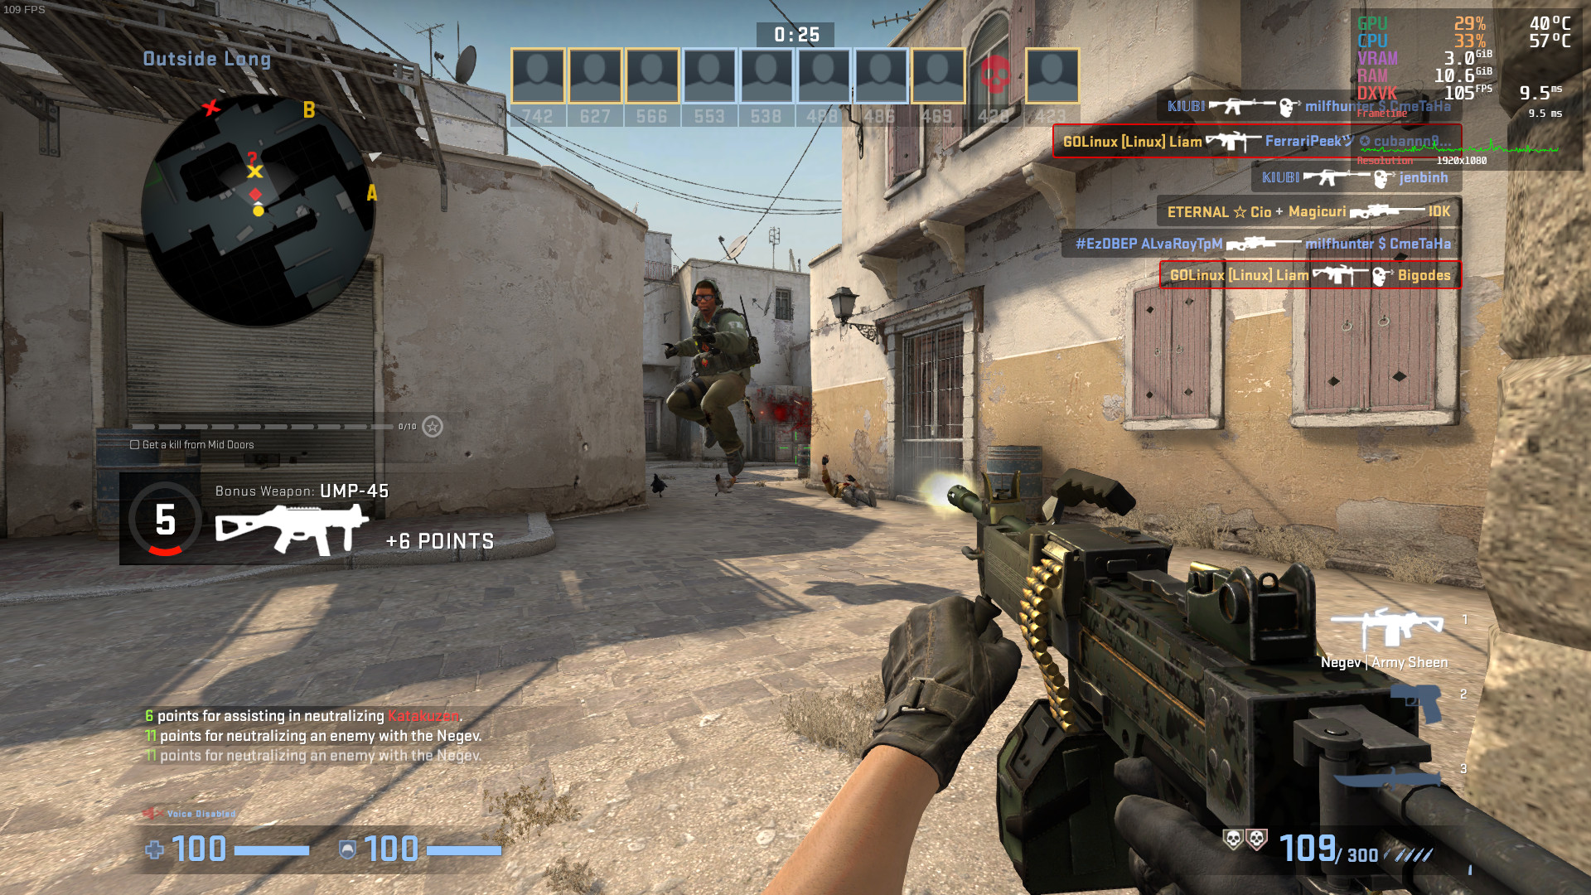
Background
Video games
Complex and Dynamic
Range of cognitive skills
Quick decisions and reactions

Slide 3
Background
Video Games
Action video games
Shooter games
First-person shooter games

Slide 4
Background
Dye, Green & Bavelier (2009)
AVG training (50 hours) significantly reduced reaction times in a range of cognitive tasks compared to those who played a control non-AVG (13% vs 6%), with no differences in accuracy.
Bediou et al. (2018; 2023)
Both meta-analyses found AVG players to outperform NVG players in cross-sectional studies, and a causal relationship between AVG training and improvements in cognitive performance.
Significant effects across a range of cognitive domains e.g., perception, top-down attention, spatial and multitasking
Sala, Tatlidil & Gobet (2018)
Meta-analysis found VG play to have negligible effects on cognitive ability.
Notes:
Early work conducted by the Green & Bavelier lab
More studies, enough for meta-analyses
But, findings are still mixed and methodology limited

Slide 5
Methodological weaknesses
Broad definitions of AVGs
Single measure of AVG expertise
Small samples of novice players
Limited expertise and training periods
VGs generally or poor AVG definition
5 hours of playtime per week across the last 6 months
Mostly male, N = 25, 5 hours per week
20 – 50 hours of training vs. 10,000+ in eSports players

Slide 6
Thesis Topics
Improving methodology of VG research
Cognitive correlates of FPS play
FPS expertise and skill acquisition
Learning ability in FPS players

Slide 7
1. Improving methodology
Broad definitions of AVGs
Single measure of AVG expertise
Small samples of novice players
Limited expertise and training periods
Counter-Strike: Global Offensive (CS:GO)
Investigation of various in-game measures
Large samples of habitual and professional CS:GO players
Inclusion of professional eSports players

Slide 8
PhD Studies
Study 1
1a: Processing speed, task mixing and switching in N = 235 CS:GO players.
1b: Processing speed, task mixing and switching in N = 300+ CS:GO players.
Study 2
2a: Processing speed, relation integration and statistical learning in N = ??? CS:GO players.
Study 3
Processing speed in FPS players and NVGP players (ORA data).Study 3
2b: Processing speed and Hebbian learning in N = 300+ CS:GO players.
Study 4
???

Slide 9
Study 1
Processing speed is our ability to process, understand and react to information
Multi-tasking is an executive function which allows us to divide of attention and switch between tasks
The relationship between AVG play, processing speed (Due, Green & Bavelier, 2009; Van Ravenzwaaij et al., 2015), task mixing and switching performance remains unclear (Cain, Landau & Shimamura, 2012; Green et al., 2012).
Little research has investigated the relationship between AVG expertise and cognitive performance - more expert AVG players may show faster processing speed and reduced mixing and switching costs.
Notes:
Reaction times & accuracy scores
Mixing and switching costs

Slide 10

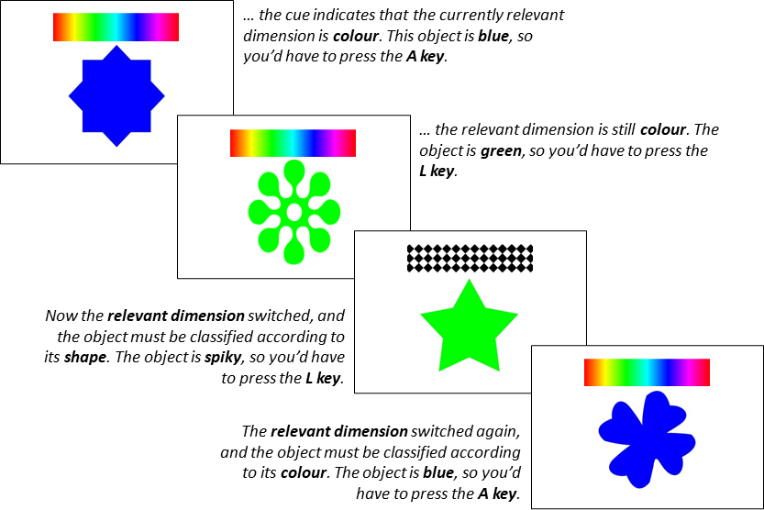
Study 1a:
Cross-sectional study of Habitual and Professional Counter-strike players
1. Interviews N = 3
Professional
10,000 thp 100 whp
Expert
2000 thp 58 whp
Casual
2000 thp 0 whp
Questionnaire
2. Cross-sectional online study N = 235
Total hours playtime
Weekly hours playtime
Current Ranking (Standard MM)
Self-rated expertise
3 Blocks:
Single-rule 1: shape then colour
Mixed-rule: switching from shape and colour
Single-rule 2: colour then shape
Within the Mixed-Rule Block:
Repetition trials: same rule in successive trials
Switch trials: rules changed from the preceding to the current trial

Slide 11
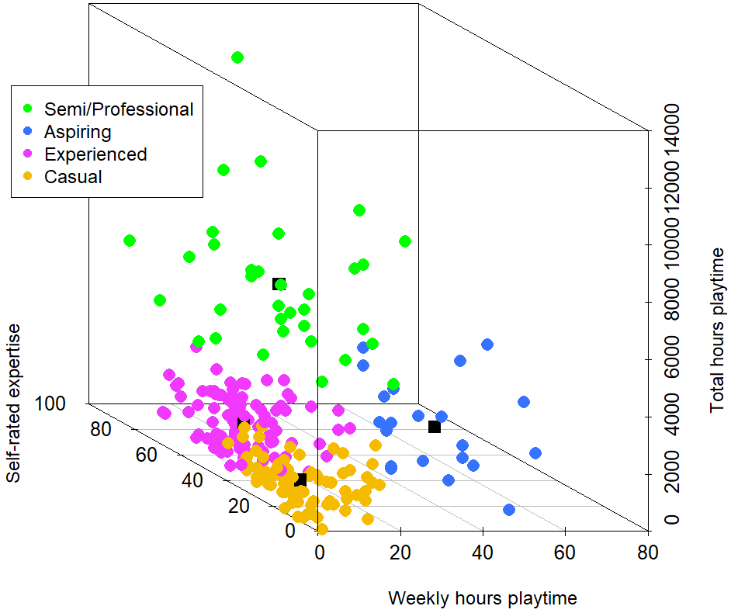
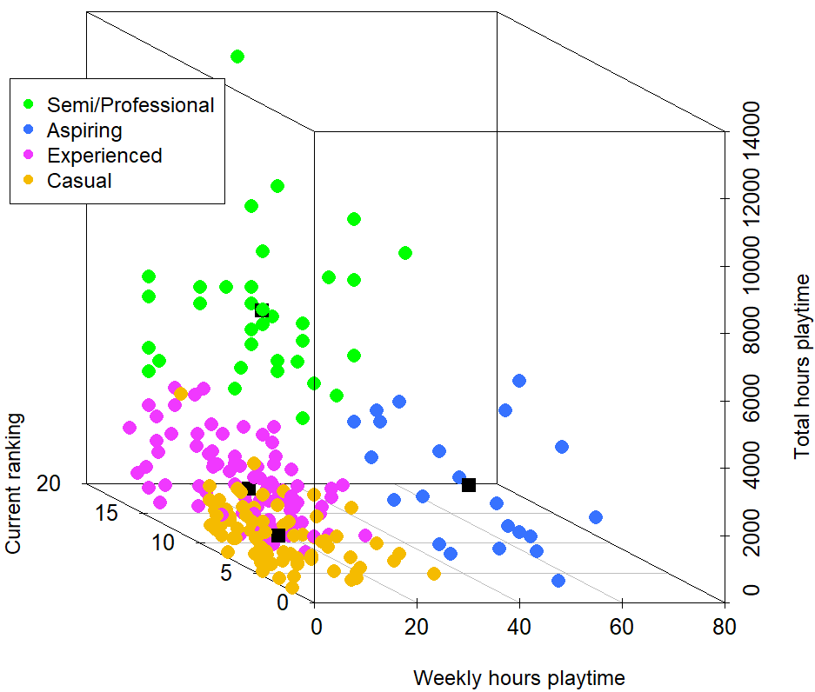
K means cluster analysis
Notes:
Algorithm which groups data into clusters, based on several variables.
Observations within the same cluster are as similar as possible (high intra-class similarity), and observations within different clusters are as dissimilar as possible (low inter-class similarity).
Consensus-based algorithm suggested k=4 best fit our data
Well describes the expertise of our players

Slide 12
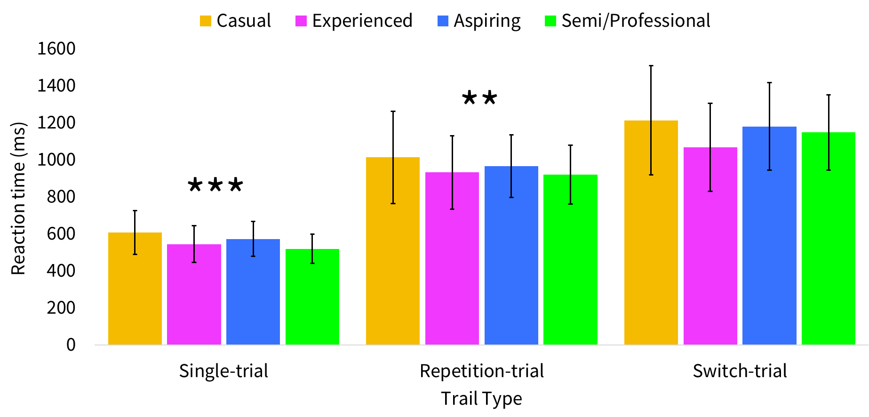
Processing speed
Notes:
More expert CS:GO players showed faster reaction times in single-rule and repetition-rule trials – relationship significant
No effect for switch-trial performance and expertise groups – next slide gives some insight into this

Slide 13
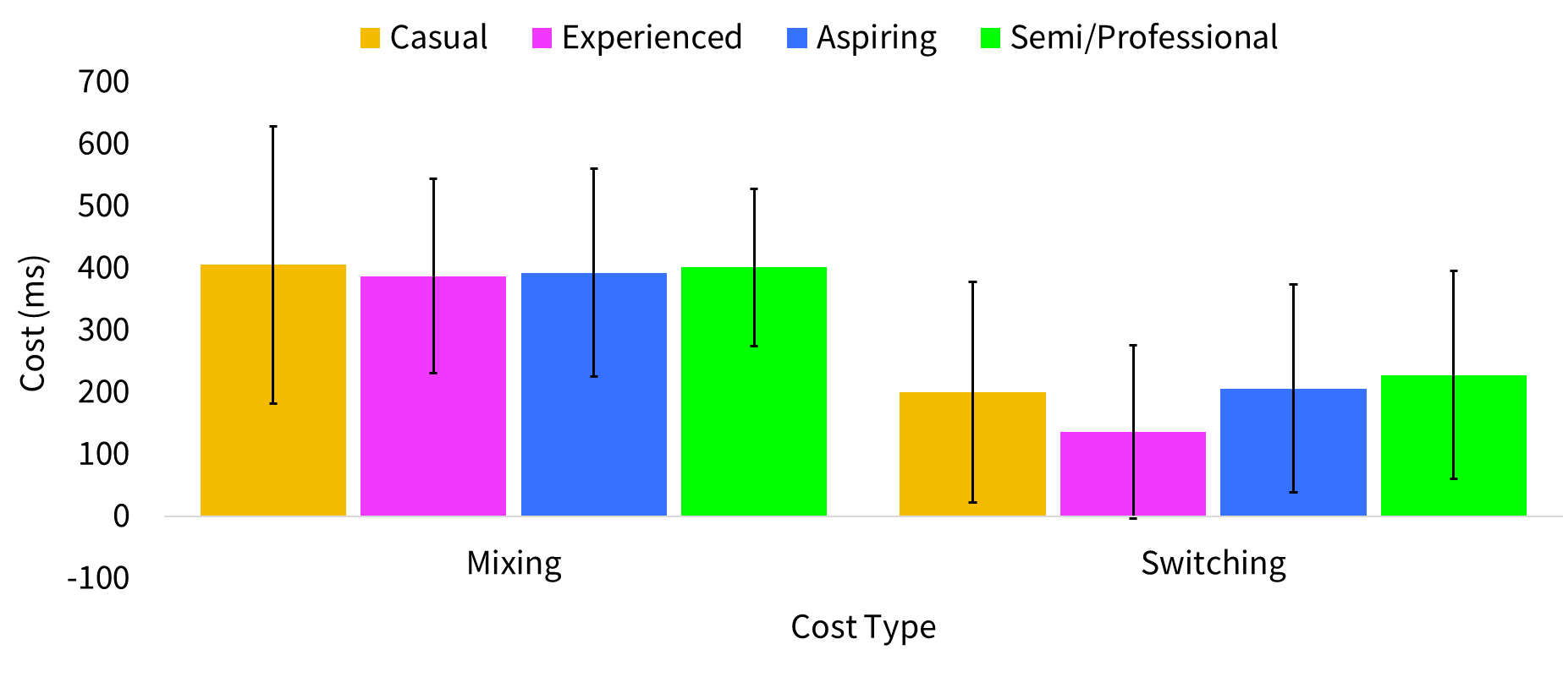
Mixing and Switching
Notes:
Mixing costs were similar across all participants – no effect here
Switching costs u-shaped relationship, the least and most expert players show the greatest costs to their reaction times when switching, whilst our experienced players in pink showed the smallest cost i.e., they are better able to switch between tasks.
Perhaps, more expert players attend to one task and do it really well, whilst less expert players attend everywhere in a greater scope – but the relationship was non-significant, so should not be over-interpreted.

Slide 14
Variable | Casual | Experienced | Aspiring | Semi/Pro
Accuracy Score | 0.94 | 0.94 | 0.98 | 0.95
Single RT *** | 607.64 | 544.76 | 572.44 | 519.12
Repetition RT ** | 1013.01 | 931.97 | 964.89 | 920.15
Switch RT | 1213.20 | 1067.60 | 1170.66 | 1147.87
Mixing Cost | 405.37 | 387.21 | 392.45 | 401.02
Switching Cost | 200.19 | 135.64 | 205.77 | 167.16

Slide 15
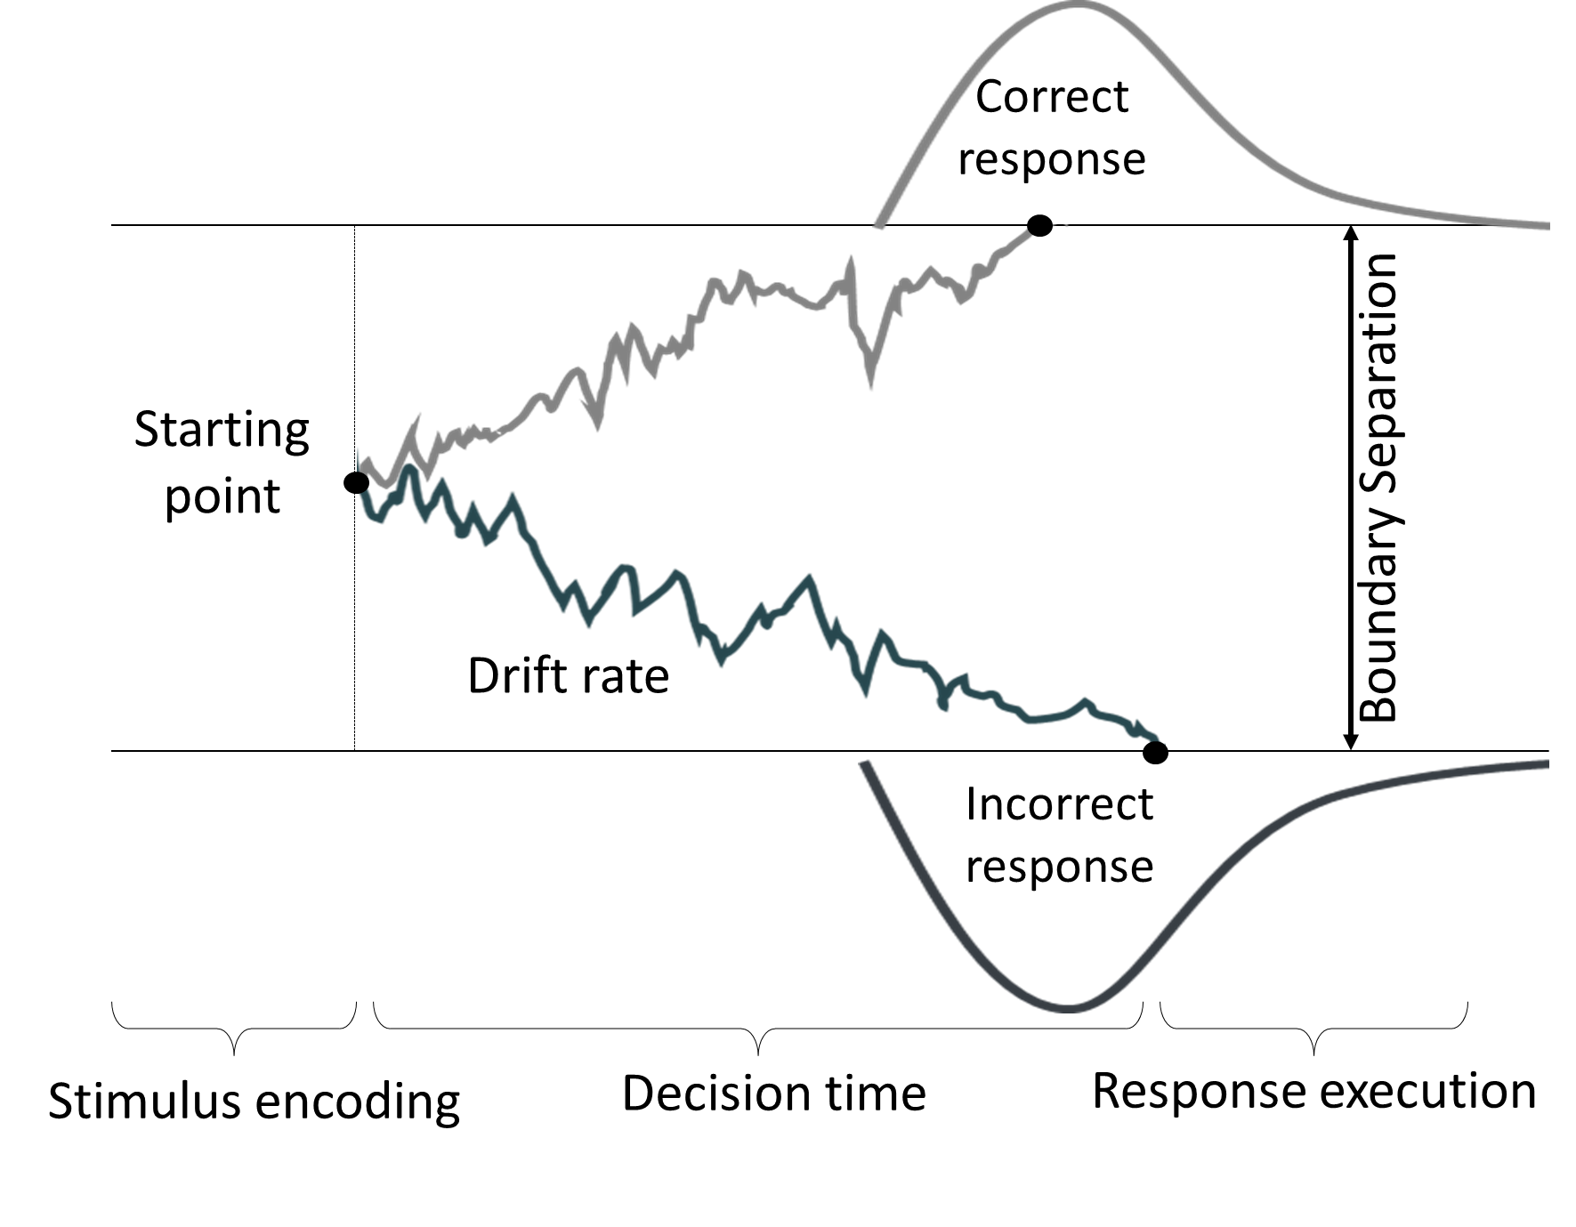
Drift-diffusion modelling
Drift rate (ν): the speed and direction of information accumulation
high ν = good performance
Boundary Separation(α): the amount of information that is considered for a decision
high α = conservative decision Non-decision time (t0): the duration of non-decisional processes such as encoding and response execution
low t0 = good performance
Notes:
Drift-diffusion model provides additional insight into the decisional processes within processing speed performance
Assumes that information is accumulated in a noisy process until one of two thresholds is hit (correct or incorrect response/blue or green).
Drift rate: speed and direction of information accumulation (+ v = correct boundary, - v = incorrect boundary) – high drift rate = good performance
Boundary Separation: (response threshold) information considered for a decision – high boundary separation = conservative in making a decision Non-decision time: duration of non-decisional processes (encoding and response execution) – low non-decision time = good performance
Allows us to analyse data from fast binary decision task: choice reaction time task

Slide 16
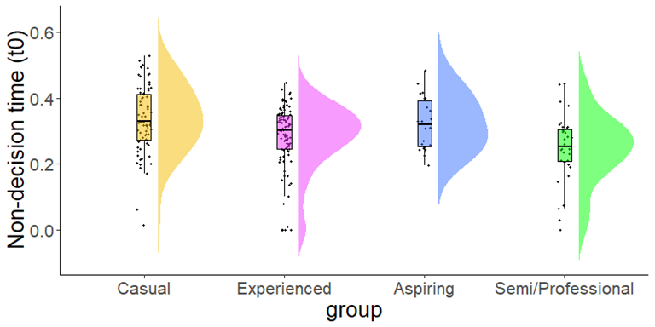
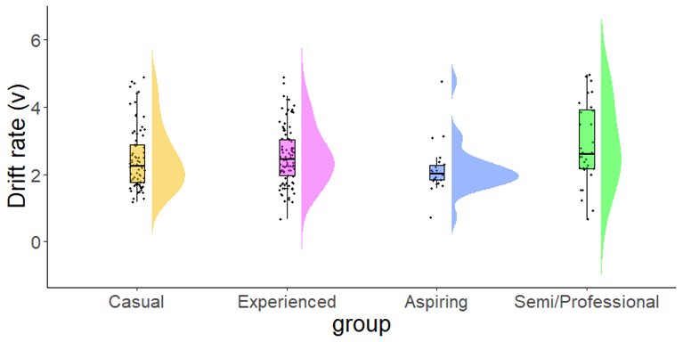
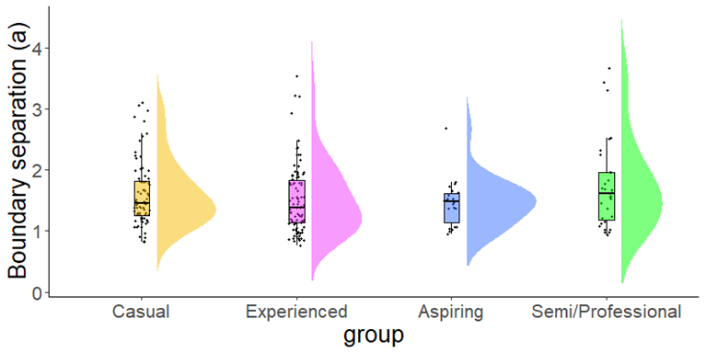
Drift-diffusion modelling
Fast-DM (Voss & Voss, 2007) with free parameters: single-rule trials only
***
***
Notes:
Fast-DM (correct and incorrect responses) – free parameters (none-set) for single-rule trial reaction times and accuracy scores.
Flexible and fast method which outputs all the parameters you need and allows you to set any parameter
Higher drift rates in more expert players = faster information accumulation
Faster non-decision times (encoding and response execution) in more expert players
No differences in boundary separation = response caution, equally as cautious decision-making across expertise groups.

Slide 17
free | Casual | Casual |  |  | Experienced | Experienced |  |  | Aspiring | Aspiring |  |  | Semi/Pro | Semi/Professional
 | fit | v | α | t0 | fit | v | α | t0 | fit | v | α | t0 | fit | v | α | t0
Mean | 0.72 | 2.46 | 1.68 | 0.34 | 0.53 | 2.73 | 1.86 | 0.28 | 0.65 | 2.15 | 1.46 | 0.32 | 0.70 | 3.06 | 1.99 | 0.25
SD | 0.26 | 0.94 | 0.70 | 0.10 | 0.34 | 1.21 | 1.47 | 0.10 | 0.28 | 0.77 | 0.38 | 0.08 | 0.28 | 1.32 | 1.08 | 0.10

Slide 18
1a: Summary
More experienced CS:GO players show faster processing speed in terms of reaction times, DDM revealed that this performance advantage is due to higher drift rates (information accumulation) and faster non-decision times.
Although non-significant, the U-shaped relationship with switch costs may suggest strategic shifts in executive attention allocation during expertise acquisition.

Slide 19
PhD Studies
Study 1
1a: Processing speed, task mixing and switching in N = 235 CS:GO players.
1b: Processing speed, task mixing and switching in N = 300+ CS:GO players.
Study 2
2a: Processing speed, relation integration and statistical learning in N = ??? CS:GO players.
Study 3
Processing speed in FPS players and NVGP players (ORA data).Study 3
2b: Processing speed and Hebbian learning in N = 300+ CS:GO players.
Study 4
???

Slide 20


Study 1b:
Cross-sectional study of Habitual and Professional Counter-strike players
Refined Questionnaire
Sample and Distribution
1a:
16-35 years
1b:
16 + years
Increased trial numbers
1a:
Single-rule = 256
Mixed-rule = 129
1b:
Single-rule = 320
Mixed-rule = 324
V3.0
+ 259 same as ORA!
Notes:
Study 1b is a replication with some improvements, which has been piloted and will be launched this year
Using our third version of the original questionnaire used in study 1b which is much improved
Widening our sample to anyone aged over 16 years old, and distributing this survey at a gaming event called EPIC.LAN, rather than distributing online which has caused some issues in terms of fake responses
Using the ORA structure, we’ve increased trial numbers of the single and mixed rule blocks by nearly 260 trials
Make our findings and analyses even more reliable

Slide 21
Study 1b:
K-means cluster analysis
Processing speed as reaction time and accuracy score
Mixing and Switching costs
Drift-Diffusion modelling

Slide 22
PhD Studies
Study 1
1a: Processing speed, task mixing and switching in N = 235 CS:GO players.
1b: Processing speed, task mixing and switching in N = 300+ CS:GO players.
Study 2
2a: Processing speed, relation integration and statistical learning in N = ??? CS:GO players.
Study 3
Processing speed in FPS players and NVGP players (ORA data).Study 3
2b: Processing speed and Hebbian learning in N = 300+ CS:GO players.
Study 4
???

Slide 23

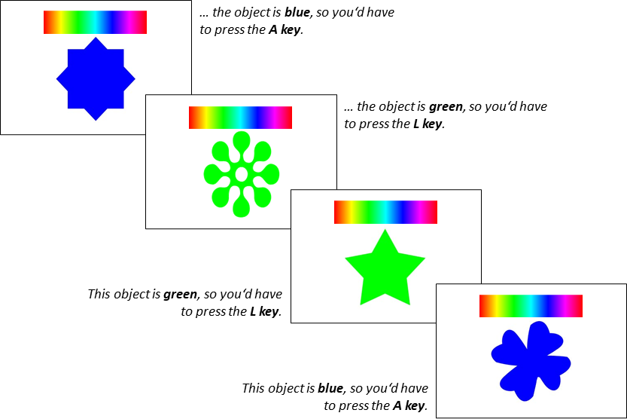
Study 3
Processing speed in first-person shooter and non-video game players: A drift-diffusion model approach
Frequency of Play | Count
Once a month or less | 244
2-3 times a month | 23
1-2 times per week | 30
3-4 times per week | 22
5-6 times per week | 19
Everyday | 26
Total | 364
N = 51 ≤35 years
50 NVG players: VGs once a month or less
50 FPS players: CS:GO players…
Choice Shapes Colour Task (160 trials)
As of 02/06/2023
Notes:
Comparison of processing speed performance in NVG players and FPS players – using ORA data
Age matching – typically my CS:GO player are under 35 years
Performance differences between these two groups will provide additional insight into the components of processing speed which underly differences in terms of the DDM parameters

Slide 24
Means across Study 1a cluster groups
Variable | Casual | Experienced | Aspiring | Semi/Pro
Total hours playtime | 624.17 | 1010.11 | 1469.11 | 5434.88
Weekly hours playtime | 10.26 | 17.05 | 55.55 | 30.41
Self-rated expertise | 26.12 | 62.96 | 48.95 | 71.65
Current ranking | 7.74 | 13.39 | 11.41 | 18.29
Notes:
NVG players vs. expert CS:GO players
30 hours per week
2000 total hours playtime

Slide 25
Expected results

Slide 26
Any Questions?
Next: other PhD students in our Lab

Slide 27


Billy & Hakan

Slide 28
Does active music-making as leisure activity and executive functions related?
Christ Billy Aryanto
Dr Claudia von Bastian, Dr Emma Blakey & Prof. Renee Timmers

Slide 29
Introduction
Music-related activities, musicality, and music skills (referred to active music-making) are been hypothesised to be associated with better executive functions (Okada & Slevc, 2020; Schellenberg & Weiss, 2013).
Executive functions: High-level and top-down cognitive process which is responsible for planning and regulating one's thought and behaviour (Friedman & Miyake, 2017). There are three factors:
Inhibition: A deliberate, intended, and controlled action to override dominant responses
Shifting: Switch from one task to another, activating the currently relevant and inhibiting the currently irrelevant task
Working memory updating: Replacing no longer relevant information in working memory with new information

Slide 30
Introduction
Using Friedman and Miyake (2000) executive functions model, previous findings are mixed regarding the relationship between active music-making and executive functions:
Music training has a relationship with updating, but not shifting. Inhibition has mixed results across studies (Slevc, Davey, Buschkuehl, & Jaeggi, 2016; Okada & Slevc, 2018; Porflitt & Rosas, 2020).
According to the current meta-analysis, active music-making has a moderate positive association with working memory and a small positive association with shifting and inhibition (Aryanto et al., in prep).

Slide 31
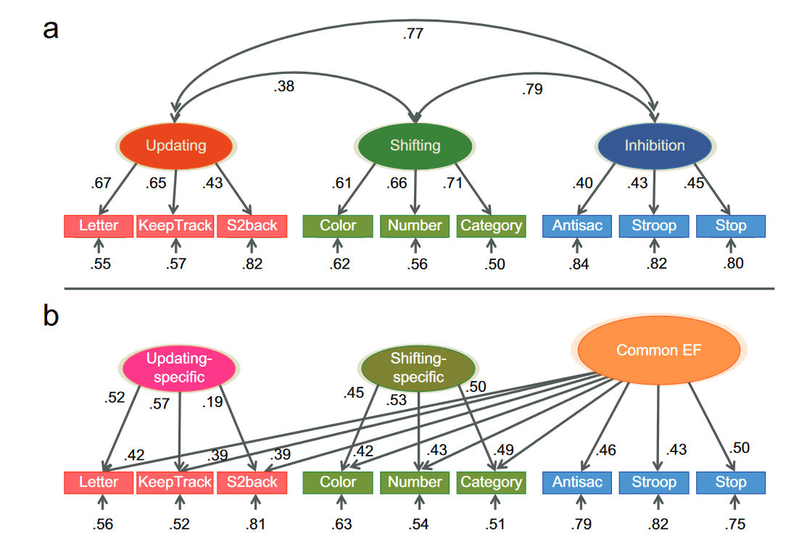
Unity and Diversity of Executive Functions (Miyake & Friedman, 2012)
a: three-factor model
b: bi-factor model
Updating: constant monitoring, deletion and addition of WM items
Shifting: switching between tasks
Inhibition: overriding of dominant responses
Notes:
Present two representations of the unity and diversity of EF: latent factors in circles and cognitive tasks in rectangles
- Three types of EF (updating, shifting and inhibition) which are substantially correlated with each other (unity) but are also separate factors (diversity).
Updated framework below presents the Common EF latent variable of which all EF tasks load (unity) and two other latent variables on which updating and shifting tasks load (diversity). Inhibition tasks here perfectly correlate with Common EF latent variable.
Background for Billy’s study – investigates the relationship between EFs and leisure activities

Slide 32
Research Plan
Research question: How strong is the relationship between playing music and executive functions?
Predictor variable
Leisure activity: Single question on playing music, answer with 6-points Likert scales
Outcome variable
Shifting: Switching tasks (drawings, shapes, numbers)
Inhibition: Go/no-go, number stroop, Simon
Working memory: Updating, binding, continuous reproduction
Frequency of Play | Count
Once a month or less | 239
2-3 times a month | 26
1-2 times per week | 27
3-4 times per week | 16
5-6 times per week | 16
Everyday | 47
Total | 371
As of 05/06/2023

Slide 33
Research Plan
Research question: How strong is the relationship between playing music and executive functions?
Predictor variable
Leisure activity: Single question on playing music, answer with 6-points Likert scales
Outcome variable
Shifting: Switching tasks (drawings, shapes, numbers)
Inhibition: Go/no-go, number stroop, Simon
Working memory: Updating, binding, continuous reproduction
Other potential variables
Fluid intelligence: Matrix reasoning, paper folding, letter sets
Other variables: Sites, demographics (age, SES)

Slide 34
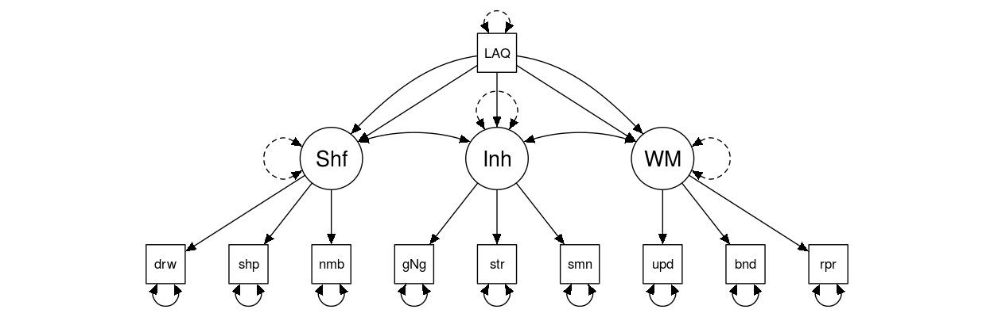
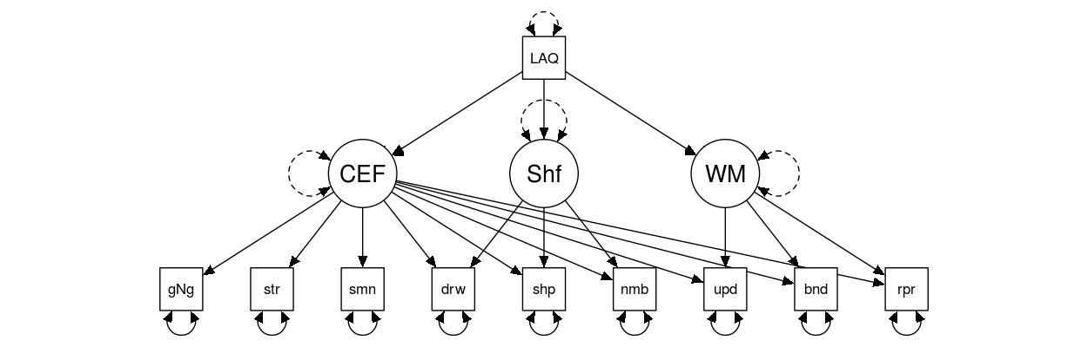
Potential Analysis
Confirmatory factor analysis
Executive functions with different models
Structural equation modelling
Leisure activity predicts executive functions
Control participants’ fluid intelligence and demographics
Different sites as random effect
Notes:
Verify the structure of observed variables within Efs with confirmatory factor analysis
Structural equation modelling is a multivariate analysis technique which analyses the structural relationships – does music playing predict Efs? Control for fluid intelligence and demographics, and different sites as a random effect

Slide 35
If you have questions…
Send them to Billy: cbaryanto1@sheffield.ac.uk
Notes:
I will try…but!

Slide 36
What is the role of sustained attention and attentional control on the relationship between working memory and fluid intelligence?
Hakan Atis
Dr Claudia von Bastian & Dr Dan Carroll

Slide 37
Introduction
Working memory refers to the maintenance of representations and goal-relevant information necessary for complex cognition.
WM capacity (WMC) significantly predicts fluid intelligence (Gf), the ability to solve novel problems and learn new information (Kane, Hambrick, & Conway, 2005; Unsworth et al., 2009). Why?

Slide 38
What is the reason for the relation between working memory capacity and fluid intelligence?
Some theories suggest that the relation WMC - GF arises from variation in attention control (Engle & Kane, 2004; Shipstead et al., 2016)
maintain goal-relevant information
disengage from irrelevant information
inhibit prepotent response and distractor objects
Sustained attention is also correlated with WMC (Unsworth & Robison, 2020). Sustained attention and attentional control factor are correlated each other (r=.-70), but distinct (Unsworth et al., 2021).

Slide 39
Research Plan
Research question: Does attentional control and sustained attention mediate the relation between working memory and fluid intelligence?
Predictor variable
Working memory: Updating, binding, continuous reproduction
Outcome variable
Fluid intelligence: Matrix reasoning, paper folding, letter sets
Mediator variables
Sustained attention: Simple RT tasks drawing, shapes, numbers
Attentional Control: Go/no-go, number Stroop, Simon

Slide 40
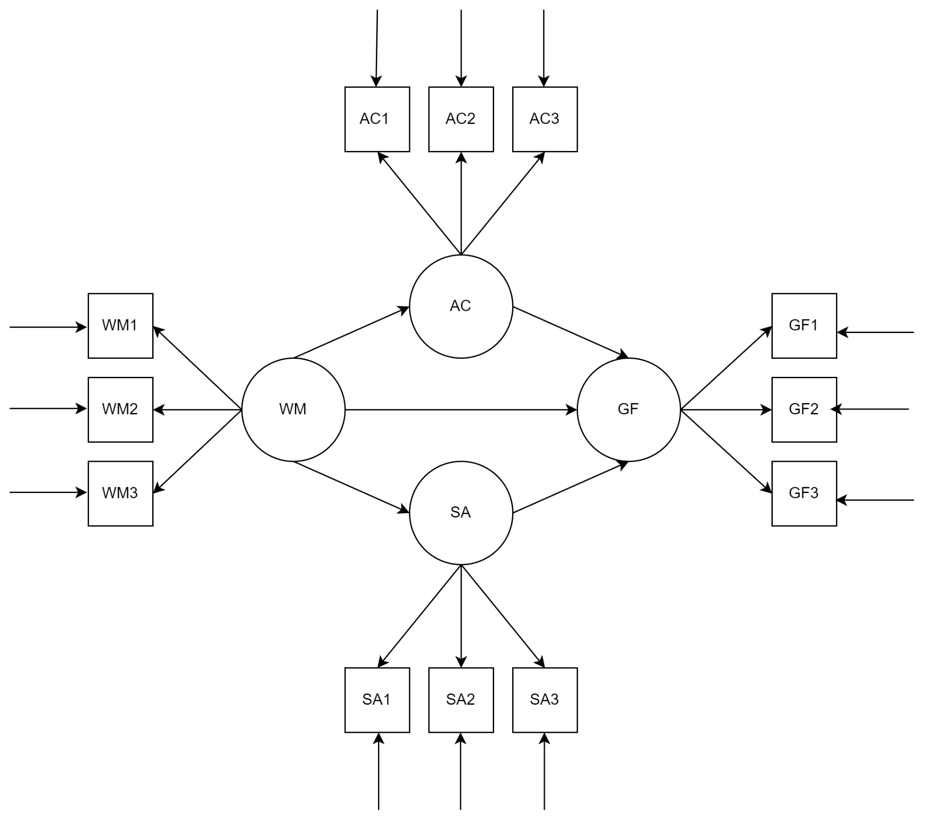
Potential Analysis
Confirmatory factor analysis
AC and SA are distinct
Structural equation modelling
WM predicts fluid intelligence (gF)
AC and SA mediates the relation between WM and gF
Notes:
Similar to Billy’s analysis method:
Verify the structure of AC and SA with confirmatory factor analysis
Structural equation modelling investigate if WM predicts fluid intelligence and if AC and SA mediate the relationship between WM and fluid intelligence

Slide 41
If you have questions…
Send them to Hakan: hatis1@sheffield.ac.uk
Notes:
I will try…but!

Slide 42
Thanks for listening
Website: www.eleanorhyde.com Twitter: @era_hyde
LinkedIn: Eleanor Hyde

